Slide 1


St. MARTIN’S ENGINEERING COLLEGE
UGC Autonomous
NBA & NAAC A+ ACCREDITED
Dhulapally, Secunderabad– 500100
Department of Computer Science and Engineering
SMART DISEASE PREDICTION SYSTEM USING MACHINE LEARNING
Batch No: A06
1. Gouti Swetha 22K81A0521
2. Kola Venkat Abhinay 22K81A0530
3. Yathirajam Srivalli Sharanya 22K81A0564
Under the Guidance of
Mr. K. Ganapathi Babu
Assistant Professor
Department of Computer Science and Engineering

Slide 2
OUTLINE
Abstract
Existing System
Architectural Design for Proposed System
ER Diagrams
Algorithms/ Techniques
30% of code
Expected outcomes
References

Slide 3
ABSTRACT
The Smart Disease Prediction System is a web-based decision support application that predicts possible diseases based on user-provided symptoms using Machine Learning algorithms.
The system allows users to select symptoms through a simple web interface.
These inputs are processed by a trained ML model that analyzes symptom patterns and predicts the most probable disease.
Along with the prediction, the system also displays a confidence score, precautionary measures, and recommended type of doctor to consult.
The project uses Random Forest as the primary algorithm due to its high accuracy and ability to handle multiple features effectively. The system is designed to support early awareness and preventive healthcare, but it is not intended to replace professional medical diagnosis.

Slide 4
EXISTING SYSTEM
In the existing system, disease identification mainly depends on manual consultation with doctors or self-diagnosis through internet searches. These methods have several limitations:
Requires physical visit to hospitals or clinics.
Time-consuming and costly.
People often misinterpret symptoms from online sources.
No intelligent system to analyze multiple symptoms together accurately.
Lack of early awareness in rural or remote areas.

Slide 5
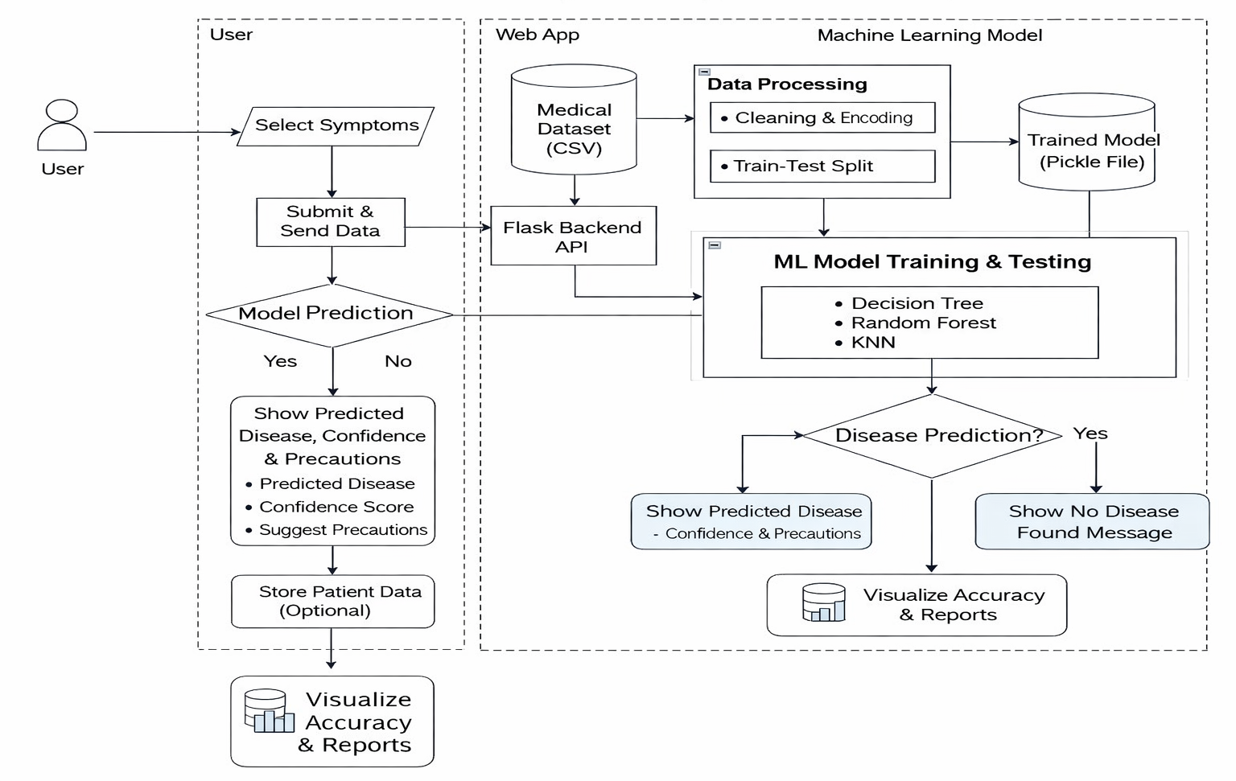
ARCHITECTURAL DESIGN FOR PROPOSED SYSTEM

Slide 6
ARCHITECTURAL DESIGN FOR PROPOSED SYSTEM
The system architecture consists of four main layers:
User Interface Layer:
Web pages built using HTML, CSS, JavaScript
Allows user to select symptoms and view results
Application Layer:
Flask framework
Handles user requests and connects frontend with ML model
Machine Learning Layer:
Trained Random Forest model
Processes symptom data and predicts disease
Data Layer:
Dataset used for training
Model file stored as pickle (.pkl)

Slide 7
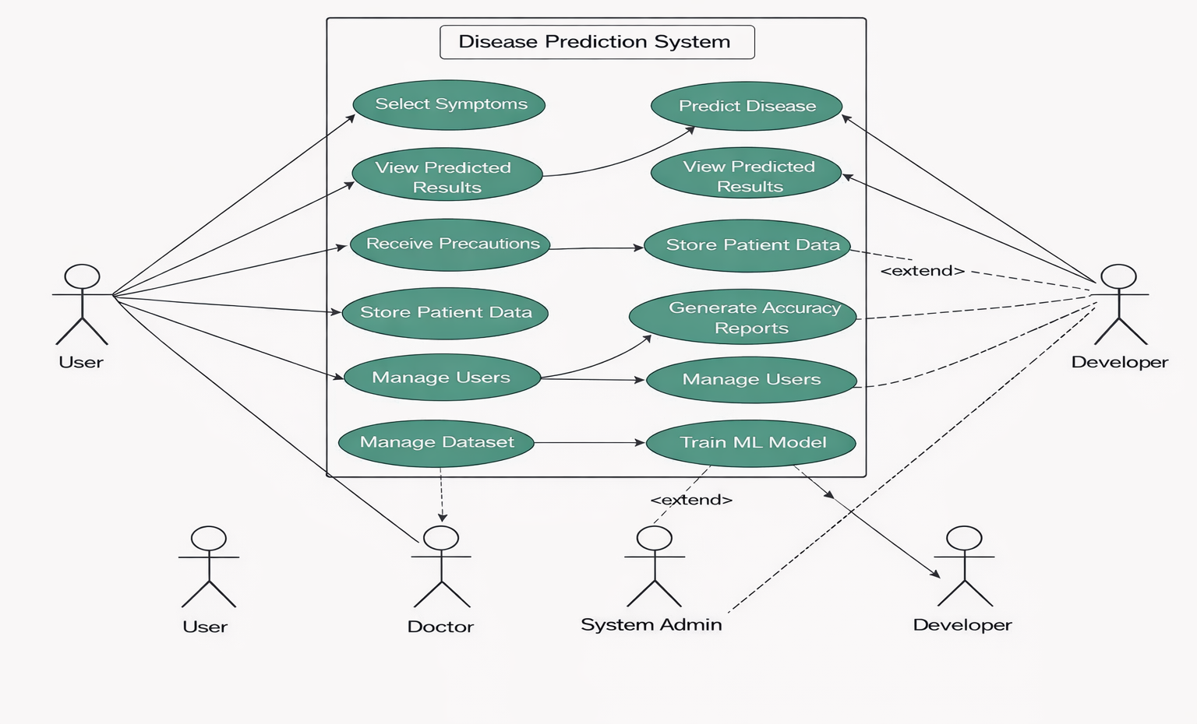
ER DIAGRAMS
Use Case Diagram

Slide 8
ER DIAGRAM
USE CASE:-
Actors
User / Patient :- Select symptoms, Initiate disease prediction, View prediction results, confidence and precautions
Admin / Doctor :-View prediction reports, Analyze disease trends, Make health advisory decisions
Use Cases
User / Patient Use Cases :- Select Symptoms, Submit Symptoms, Preprocess Symptom Data, Predict Disease, View Predicted Disease, View Confidence Score, View Precautions, View Doctor Recommendation
Admin / Doctor Use Cases :- Store Prediction Data, Generate Disease Report, Analyze Disease Trends, Monitor Prediction Accuracy, Update Disease and Precaution Data
System Use Cases:-Preprocess Symptom Input, Run Machine Learning Model (Random Forest), Calculate Confidence Score, Save Prediction Data in Database, Generate Accuracy Graphs and Reports, Display Results on Web Interface

Slide 9
ALGORITHMS/ TECHNIQUES
1. Random Forest Algorithm
Random Forest is an ensemble learning algorithm that builds multiple decision trees and combines their outputs for better accuracy. Each tree gives a prediction and the final result is chosen by majority voting.
Steps:
Load dataset
Split data into training and testing
Train Random Forest model
Test accuracy
Save trained model

Slide 10
ALGORITHMS/ TECHNIQUES
2. Data Preprocessing:-
Remove missing values
Encode symptoms as binary values (0 or 1)
Split data into features and target
3. Prediction Process:-
Take user symptom input
Convert into numerical array
Pass to trained model
Get disease and probability

Slide 11
30% OF THE CODE

Slide 12
EXPECTED OUTCOMES
1. Symptom Input Output
User successfully selects symptoms through the web interface. System accepts only valid symptom inputs (Yes/No or selected options). Selected symptoms are displayed for confirmation before submission.
2. Pre-Processing Output
Submitted symptoms are converted into numerical (binary) format. Data is normalized and arranged in the format required by the ML model. Input becomes suitable for disease prediction.
3. Disease Prediction Output
Machine Learning model processes the symptom data. Most probable disease is predicted based on trained dataset. System generates a prediction with high accuracy.

Slide 13
EXPECTED OUTCOMES
4. Confidence Score Output
System calculates prediction probability. Confidence score (in percentage) is displayed. User understands reliability of the prediction.
5. Doctor Recommendation Output
System suggests the type of doctor to consult. User knows which specialist is suitable for the condition.
Data Storage Output
User input and prediction results are stored in database. Data is available for analysis and report generation.
.

Slide 14
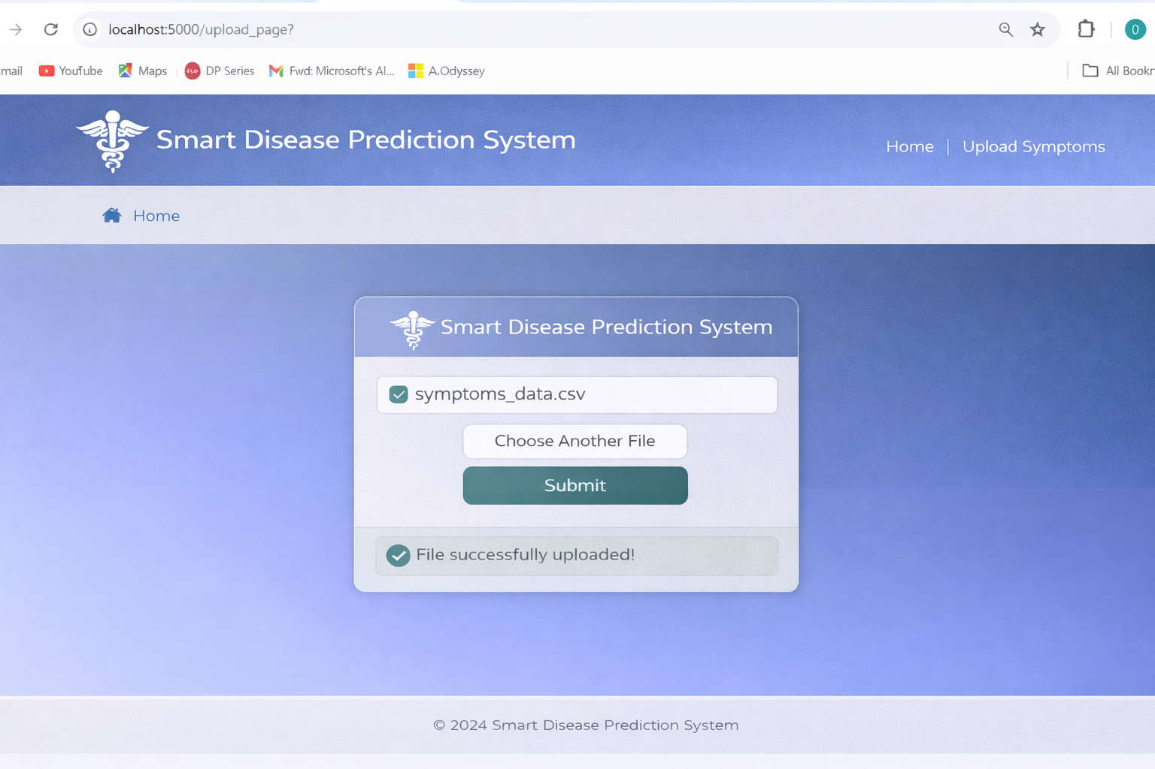
EXPECTED OUTCOMES

Slide 15
REFERENCES
[1] Breiman, L., “Random Forests,” Machine Learning Journal, vol. 45, no. 1, pp. 5–32, 2001.
[2] Quinlan, J. R., “Induction of Decision Trees,” Machine Learning Journal, vol. 1, no. 1, pp. 81–106, 1986.
[3] Cover, T., and Hart, P., “Nearest Neighbor Pattern Classification,” IEEE Transactions on Information Theory, vol. 13, no. 1, pp. 21–27, 1967.
[4] Pedregosa, F., et al., “Scikit-Learn: Machine Learning in Python,” Journal of Machine Learning Research, vol. 12, pp. 2825–2830, 2011.
[5] Dua, D., and Graff, C., “UCI Machine Learning Repository,” University of California, Irvine, School of Information and Computer Sciences, 2019.

Slide 16
REFERENCES
[6] Esteva, A., et al., “A Guide to Deep Learning in Healthcare,” Nature Medicine, vol. 25, pp. 24–29, 2019.
[7] Rajkomar, A., Dean, J., and Kohane, I., “Machine Learning in Medicine,” New England Journal of Medicine, vol. 380, pp. 1347–1358, 2019.
[8] Kononenko, I., “Machine Learning for Medical Diagnosis: History, State of the Art and Perspective,” Artificial Intelligence in Medicine, vol. 23, no. 1, pp. 89–109, 2001.
[9] Shickel, B., Tighe, P., Bihorac, A., and Rashidi, P., “Deep EHR: A Survey of Recent Advances in Deep Learning Techniques for Electronic Health Record”, IEEE Journal of Biomedical and Health Informatics, vol. 22, no. 5, pp. 1589–1604, 2018.

Slide 17
REFERENCES
[10] Flask Documentation, “Flask Web Framework for Python,” Pallets Projects Official Documentation, 2023.
[11] Python Software Foundation, “Python Programming Language Documentation,” Python Official Documentation, 2023.
[12] Tomar, D., and Agarwal, S., “A Survey on Data Mining Approaches for Healthcare,” International Journal of Bio-Science and Bio-Technology, vol. 5, no. 5, pp. 241–266, 2013.

Slide 18
QUERIES??

Slide 19
THANK YOU

